Slide 1





AIPS
TECH
CYBER
SECURITY
INTRUSION PREVENTION SYSTEM & ARTIFICIAL INTELLIGENCE

Slide 2

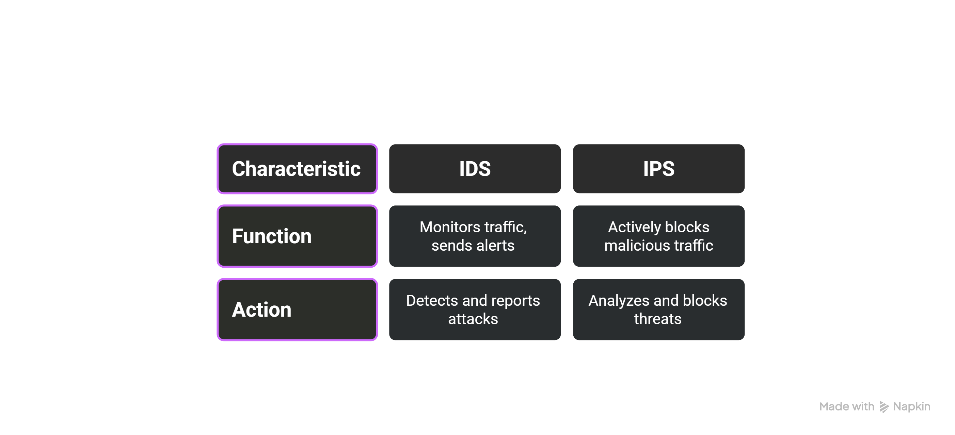
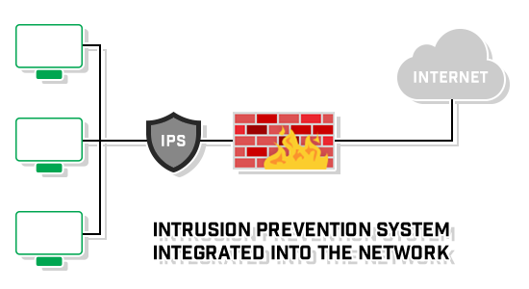
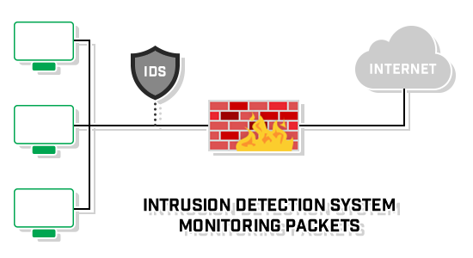
AIPS
TECH
Comparison
In-line
IPS & IDS
Out-of-band

Slide 3
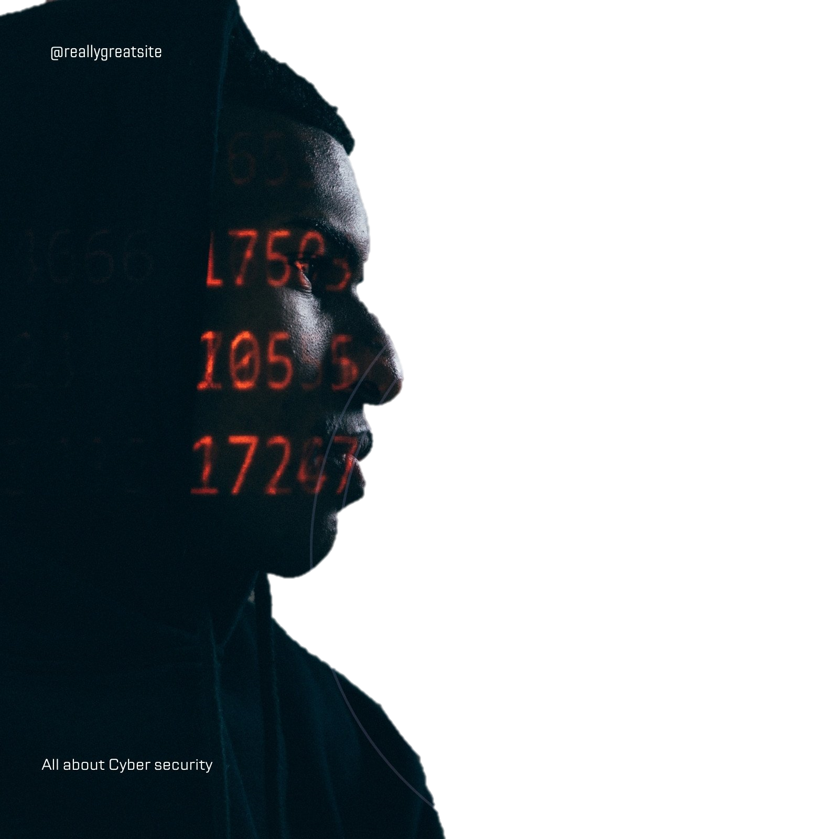


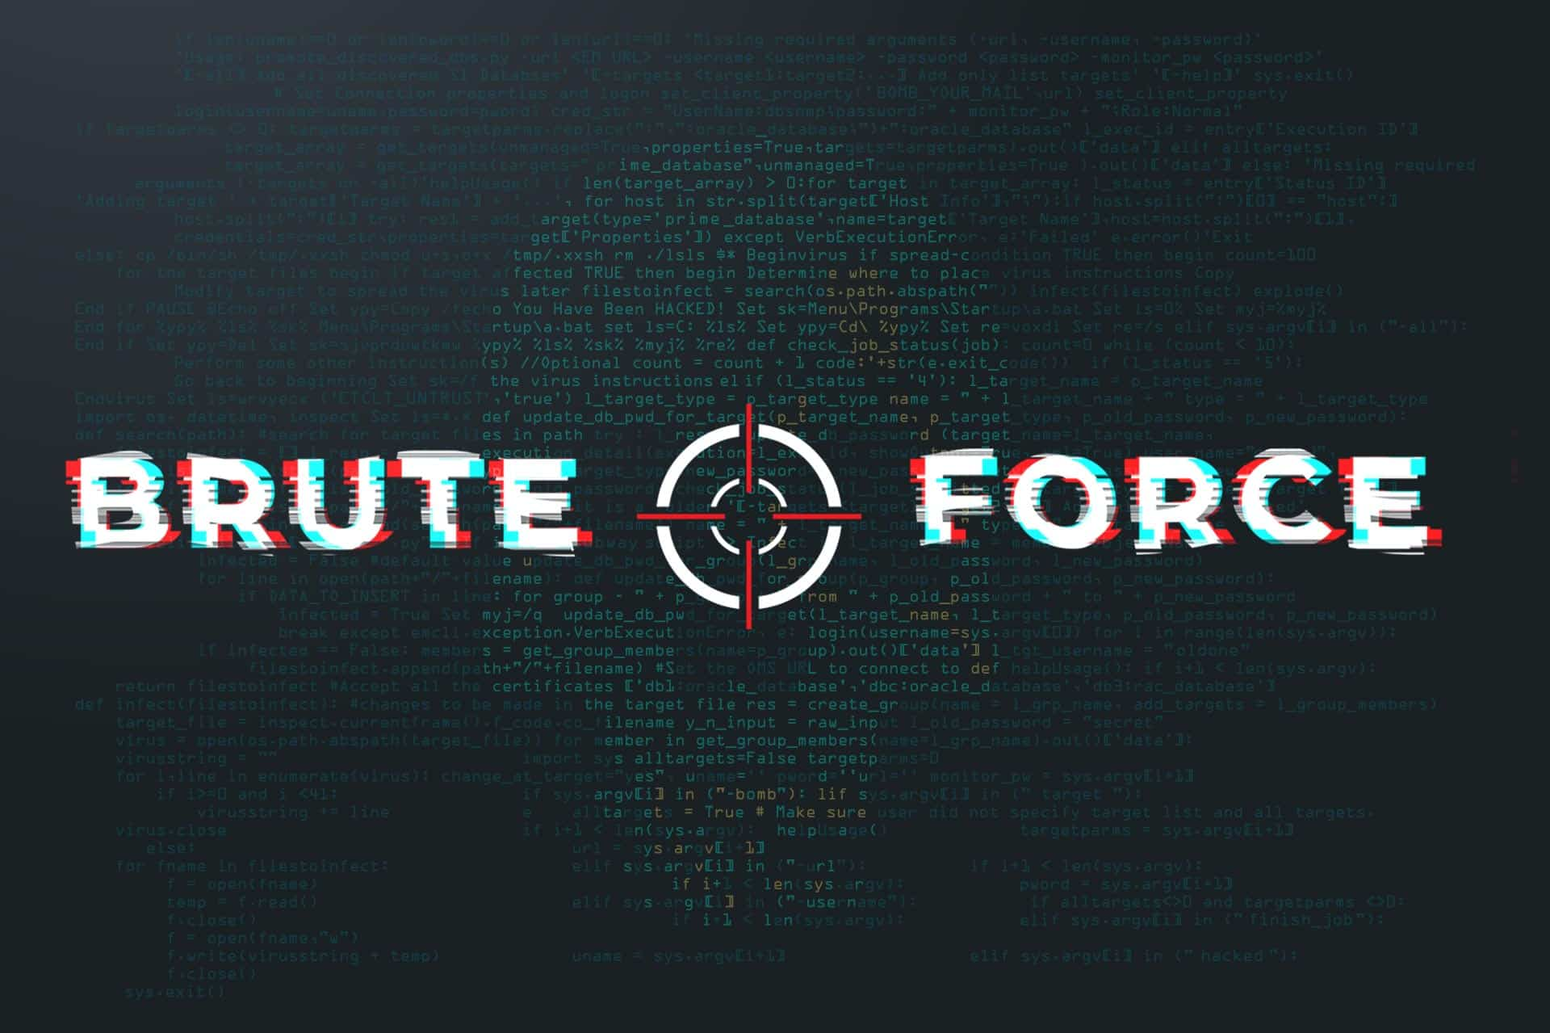
AIPS
TECH
OUR
PROJECT
DDOS
BRUTE FORCE
PORT SCAN
Overloads a server with traffic to make it crash or go offline.
Tries many password until it finds the correct one.
Scans a device to find open ports that can be attacked.

Slide 4
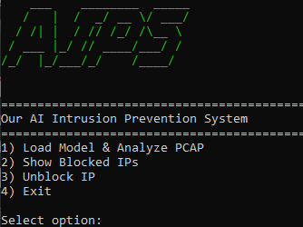

AIPS
AIPS
TECH

Slide 5



AIPS
TECH
How the Project
Works
Key Features:
Supports multiple attack types.
Blocking malicious Ips.
User-friendly CLI interface.
Built with Python, using libraries like pyshark, scapy, and joblib.

Slide 6

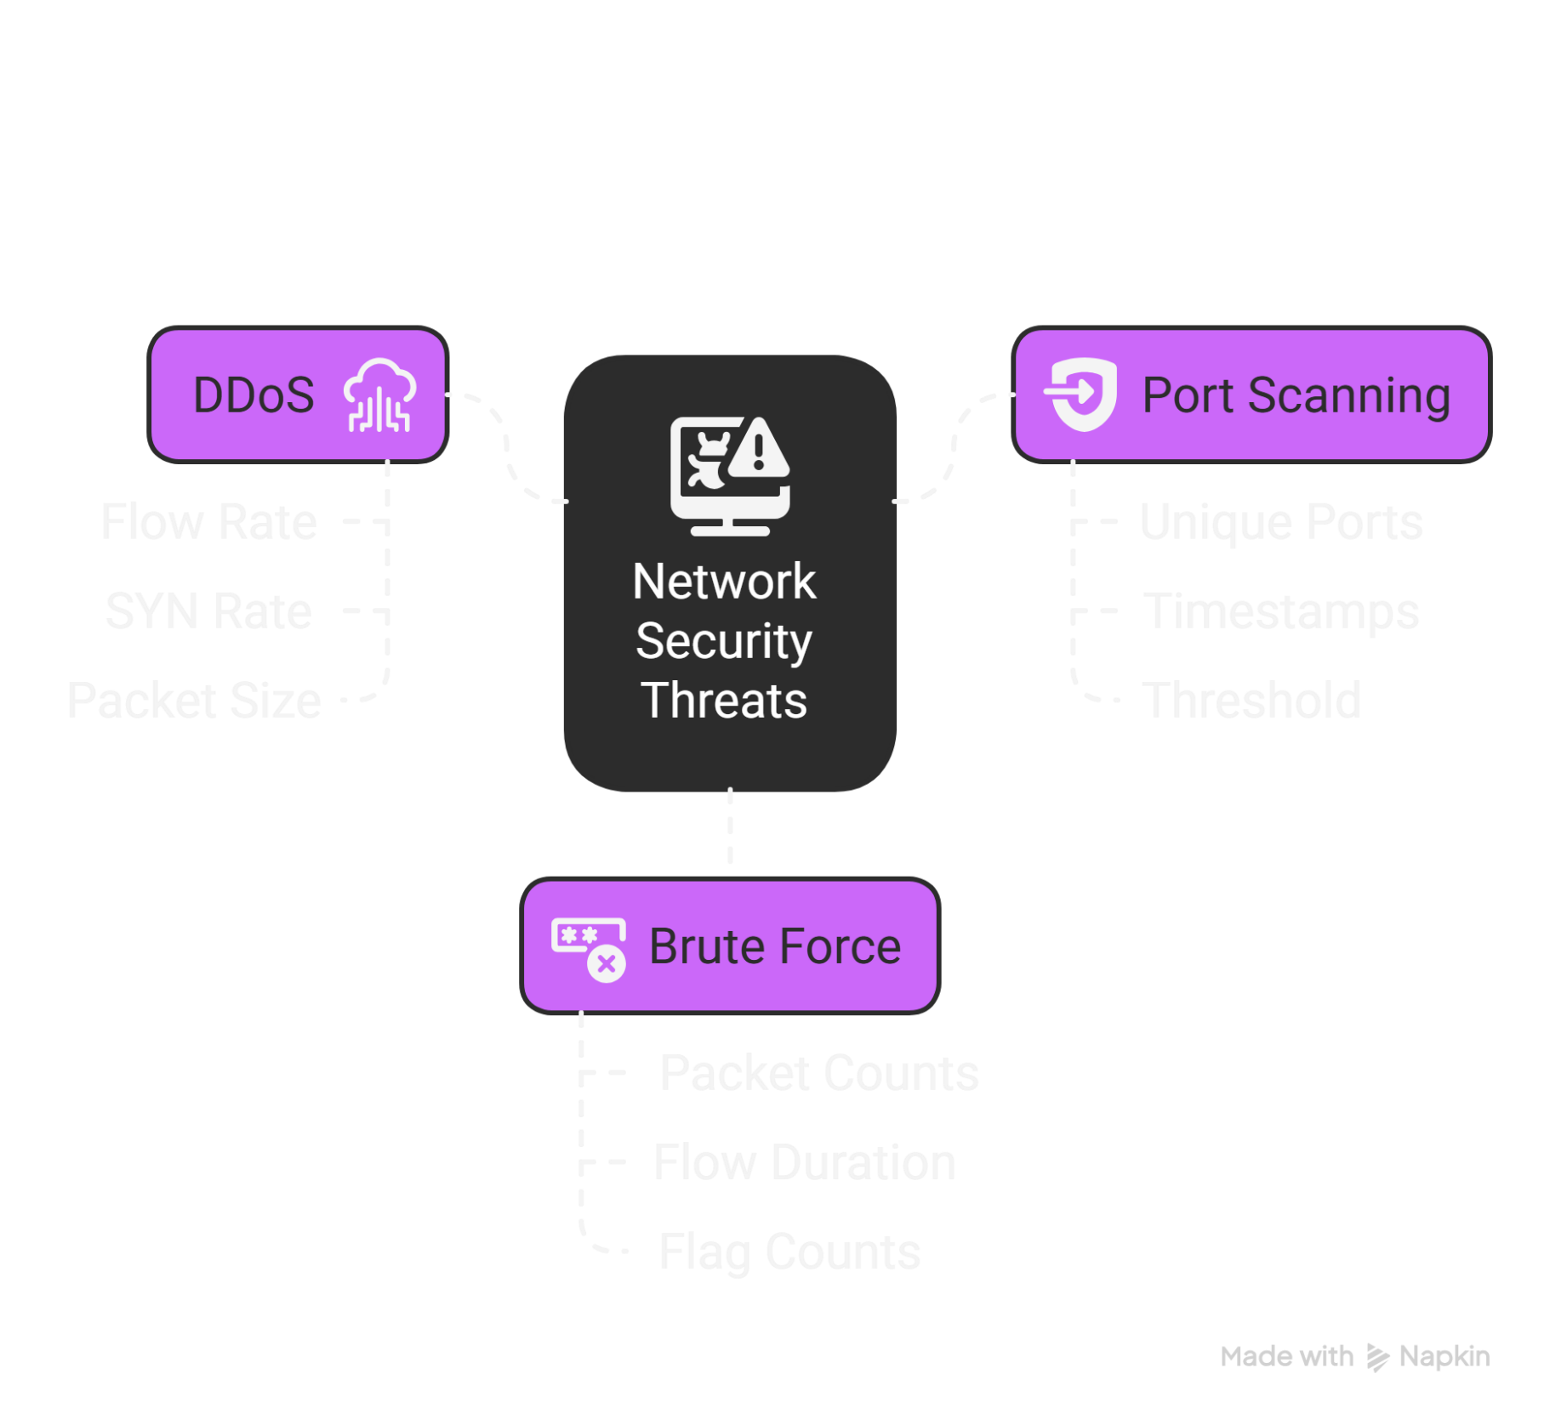


AIPS
TECH
How to detect
Attacks

Slide 7
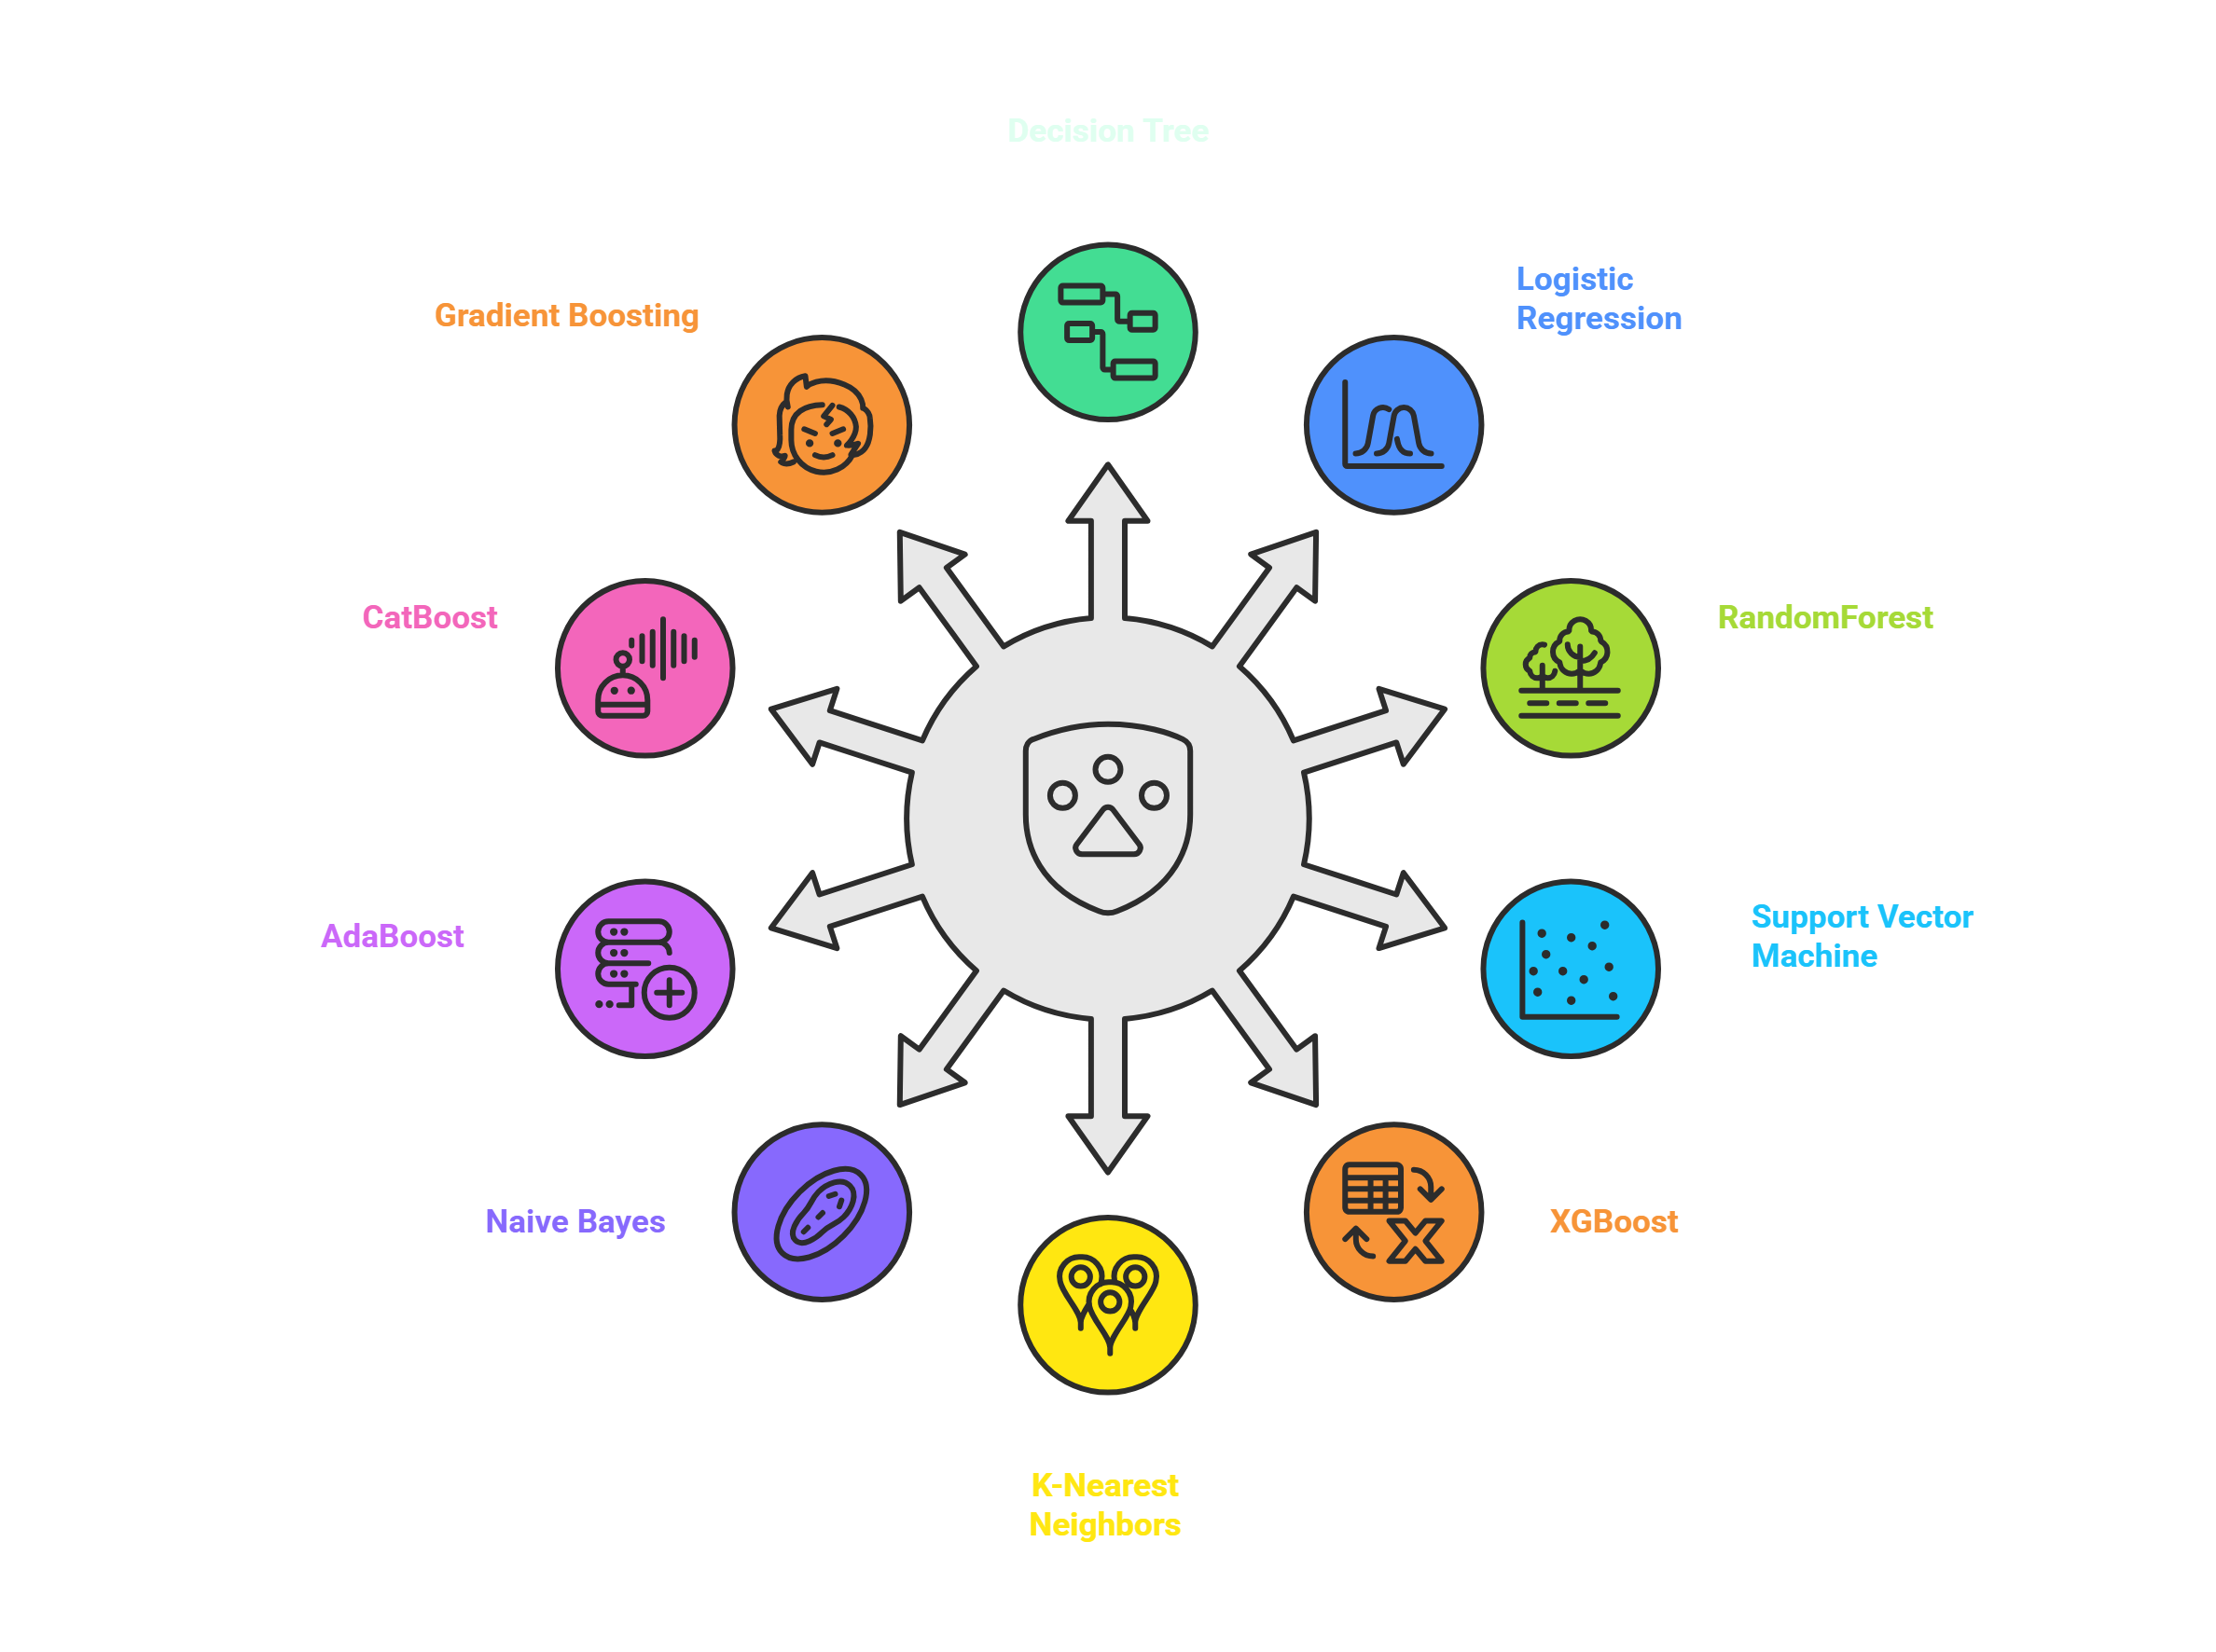

AIPS
TECH
ML MODELS
which differ in accuracy. Users can freely choose any model based on their needs:

Slide 8
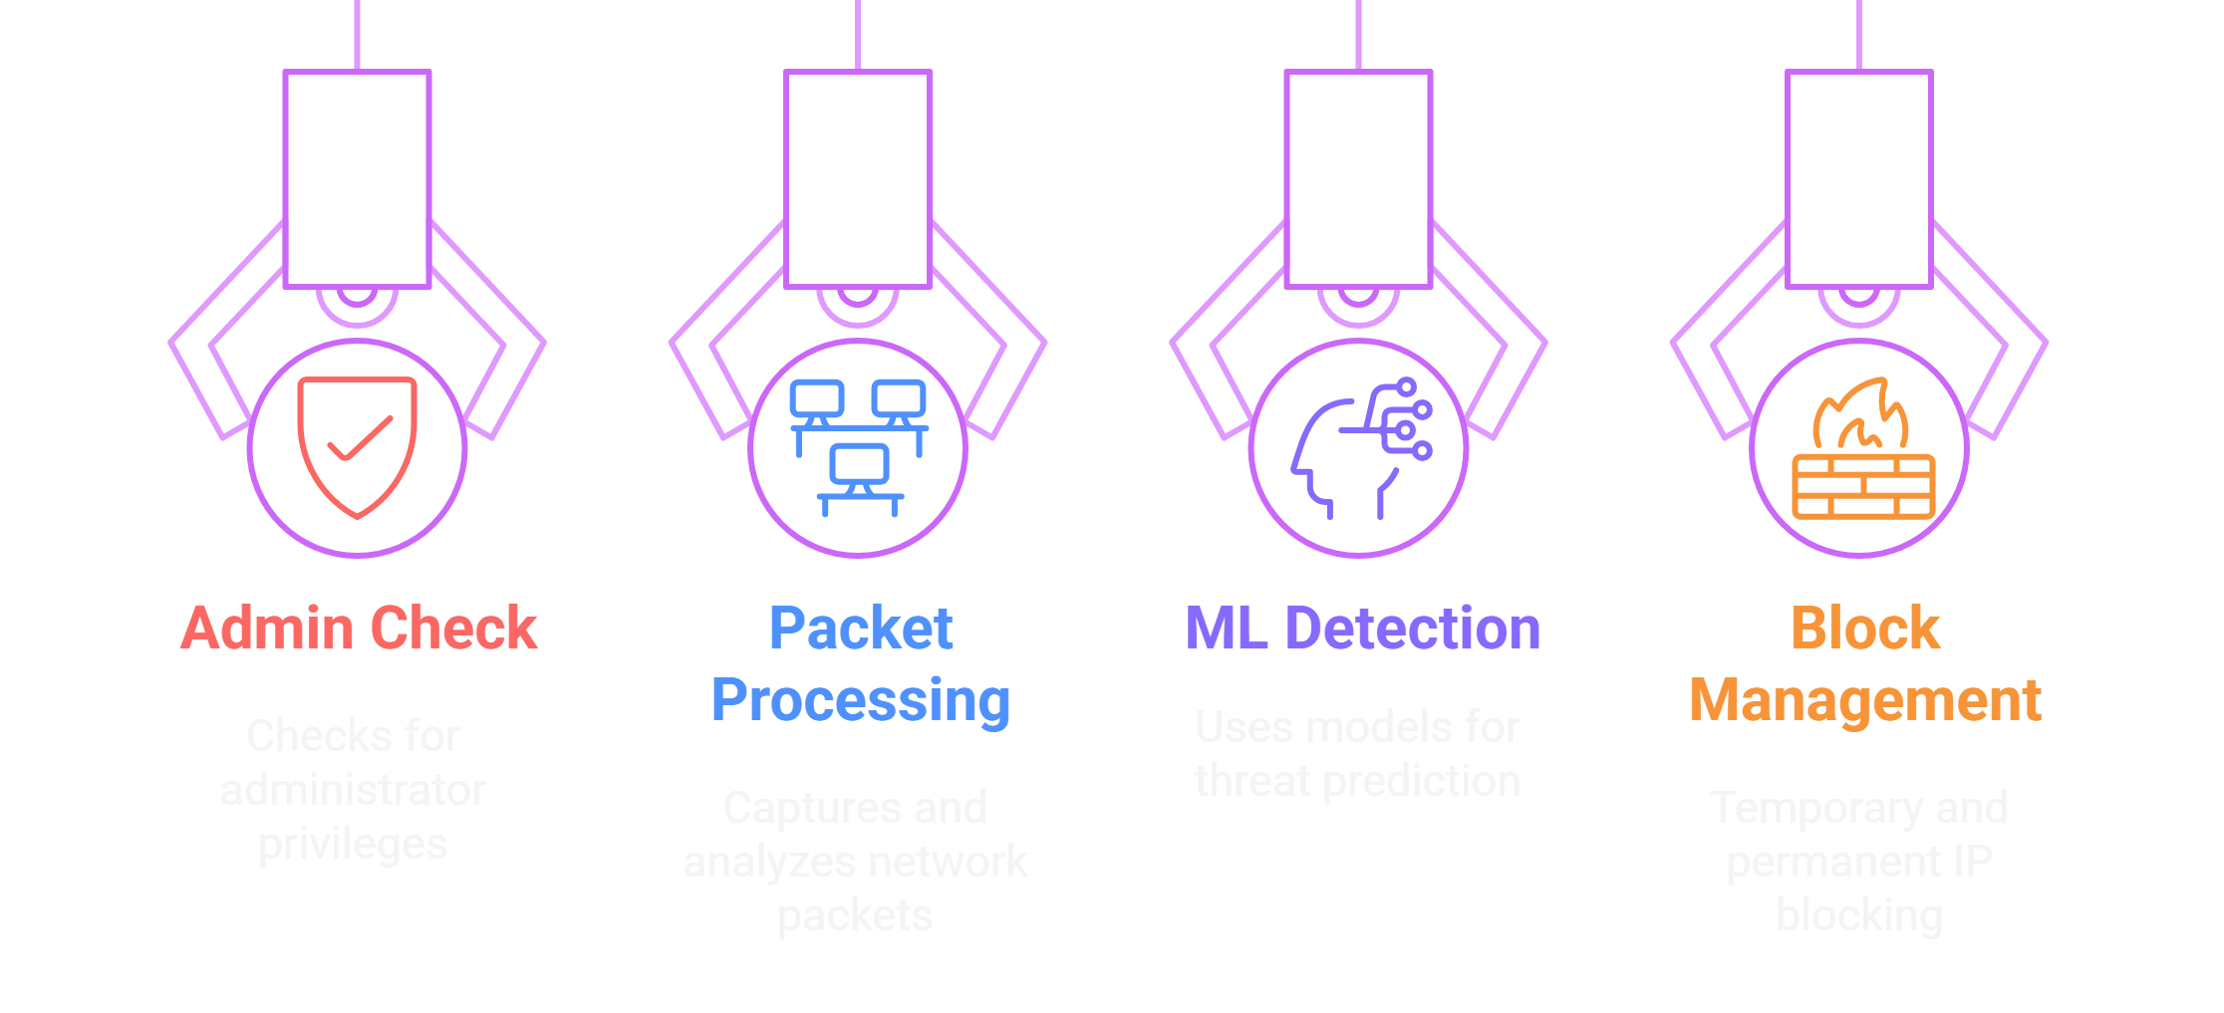

AIPS
TECH
Script
Structure
Process:
Select attack type (DDoS, Port Scanning, Brute Force)
Provide model and PCAP file paths
Each attack type uses at least 10 ML models
View detection results and choose actions (block/ignore)
Unblocking or “Removes IP” from blocklists

Slide 9



AIPS
TECH
Future
Enhancement
AIPS provides a robust solution for network intrusion prevention
Supports multiple attack types with ML-based detection
User-friendly CLI for analyzing PCAP files and managing blocks
Real-time network monitoring
Support for additional attack types

Slide 10

TECH
AIPS
DEMO
It’s Time to DEMO Now!
SECTION

Slide 11

AIPS
TECH

Slide 12
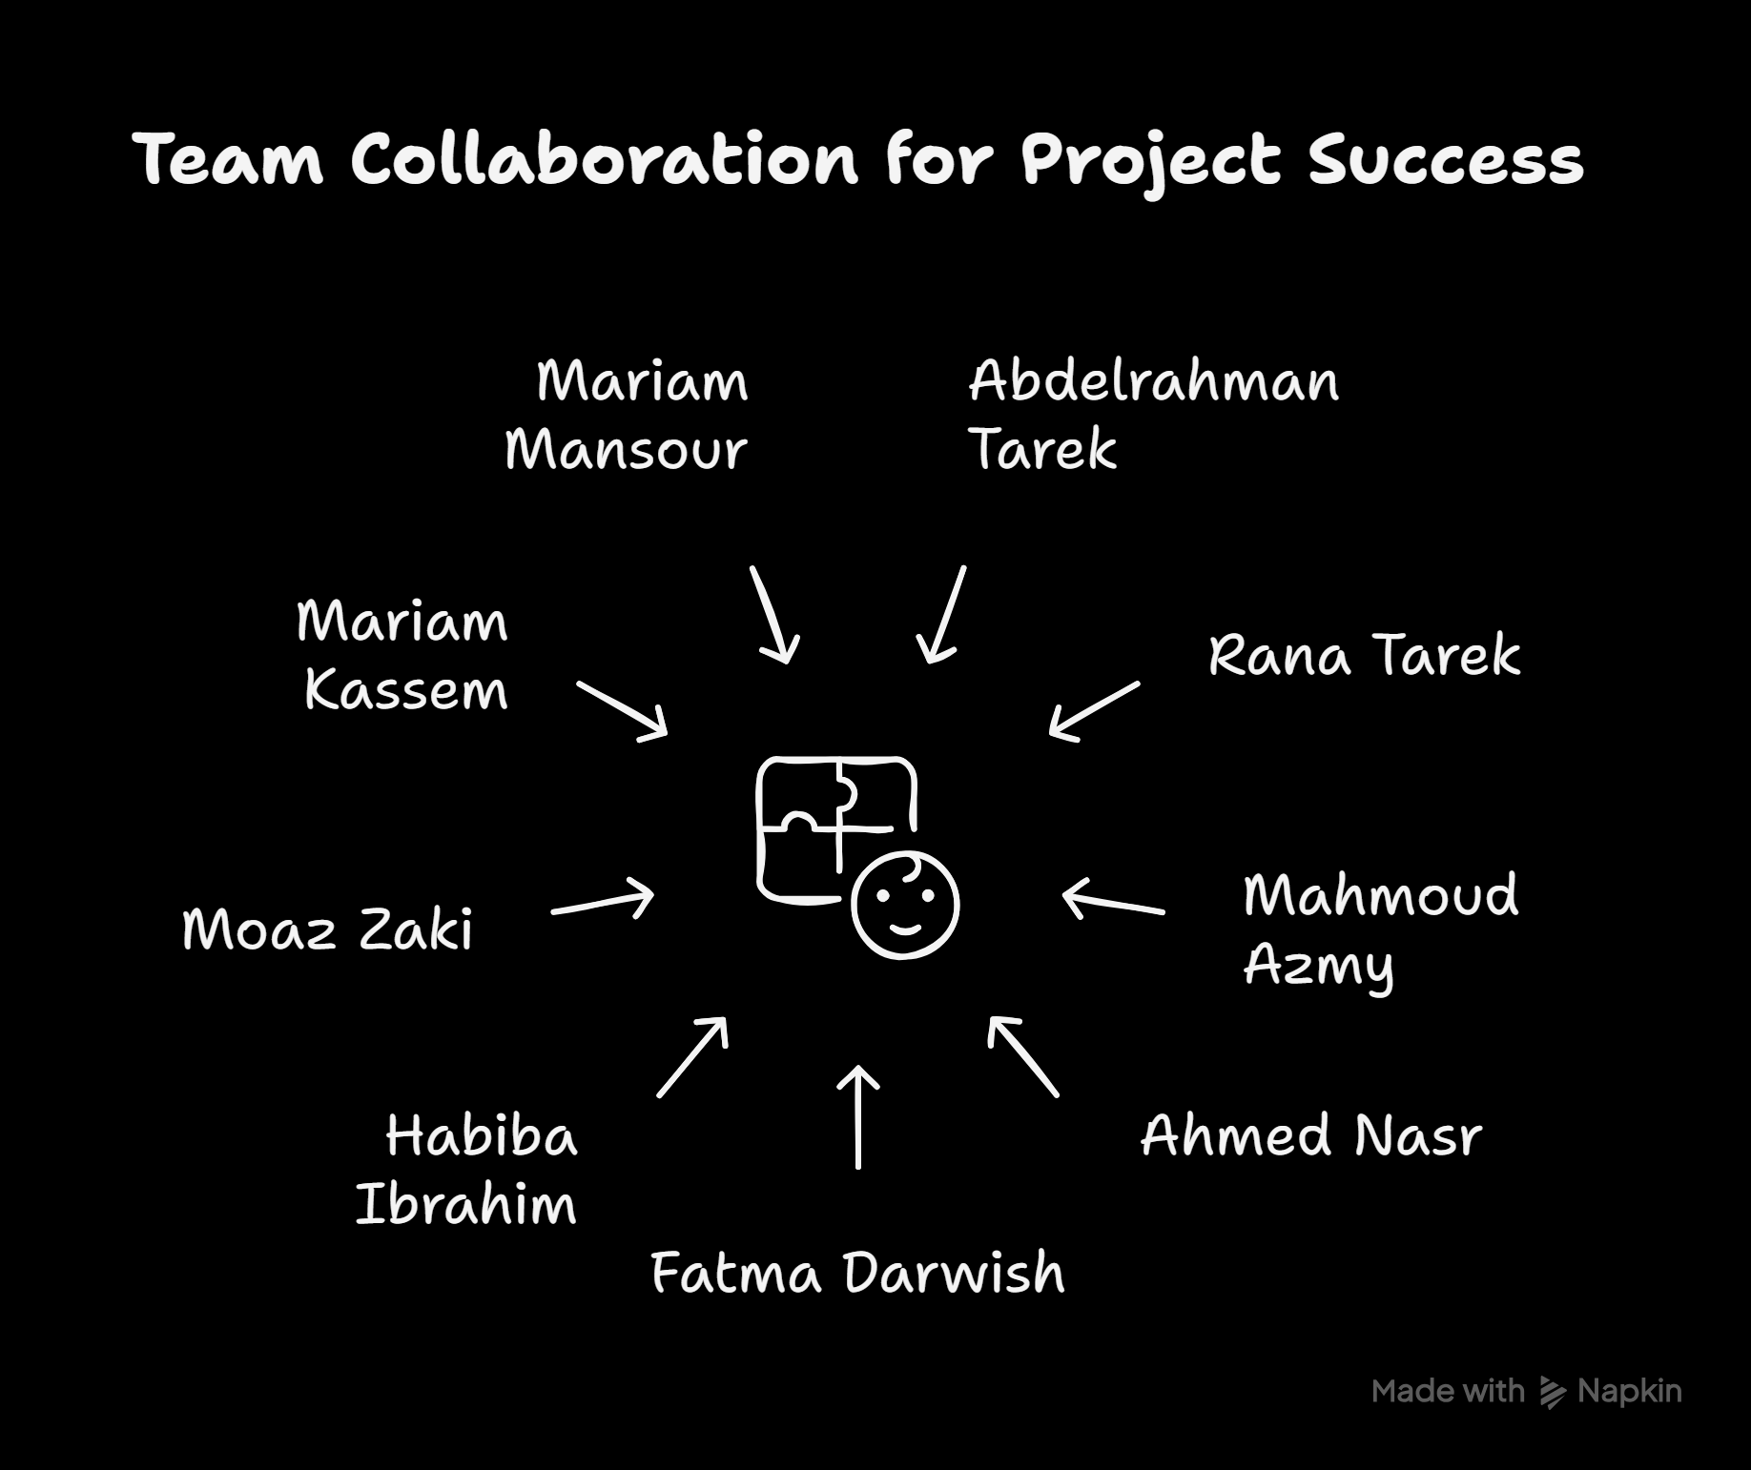

AIPS
TECH
OUR BEST
TEAM

Slide 13

AIPS
TECH
Q&A
Convey your arguments about this topic.
AIPS

Slide 14
AIPS
TECH
THANK
YOU
Thanks to Dr: Aida Nasr & For Your Listening

